Slide 1
CAPA Review

Slide 2

Agenda
1) Action Item Update | All
2) CPC AMR Action Item Updates | Bill C
3) QE: CARs / Internal Process Audits | Denise E
4) Internal Technical Audits | Lenore B
5) Field Services | John C for Steve S
6) FUS Samples | Ray B
7) Rework (External, Internal) | Joe T
8) Meeting Wrap-up | All
9) Structural Changes and CAPA | All

Slide 3
Agenda – revised
 | PS Business Divisions / Functions | UL Mark Programs | UL Functions
1) Action Item Update | X | X | X
2) CPC AMR Action Item Updates | X | X | X
3) QE: CARs / Internal Process Audits | X | X | X
4) Internal Technical Audits |  | X
5) Field Services |  | X
6) FUS Samples | X
7) Rework (External, Internal) | X
8) Customer Satisfaction | X | X

Slide 4
Questions?

Slide 5
Controlled Documents B&P Updates
September 6, 2013
September 9, 2013

Slide 6


Documentation Update Plan
Collaboration with stakeholder Points of Contact

Slide 7
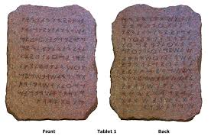


Documentation Update Plan

Slide 8






Buy & Pay Training
Accreditation
Shared Documents

Slide 9
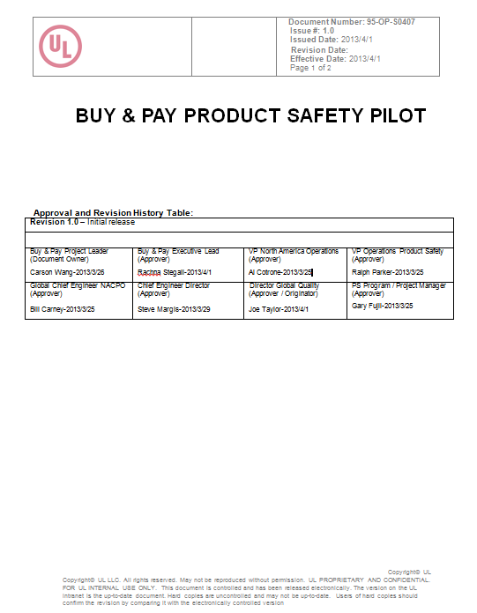
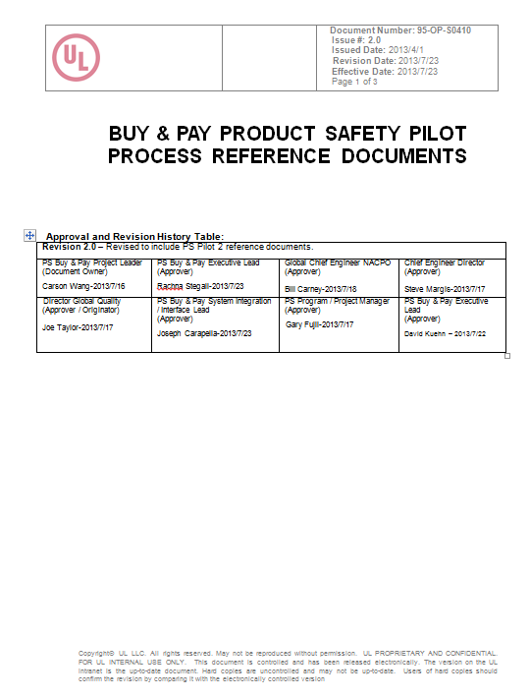
PS Pilot Process Documents
95-OP-S0407
95-OP-S0410

Slide 10
Questions?

